Slide 1
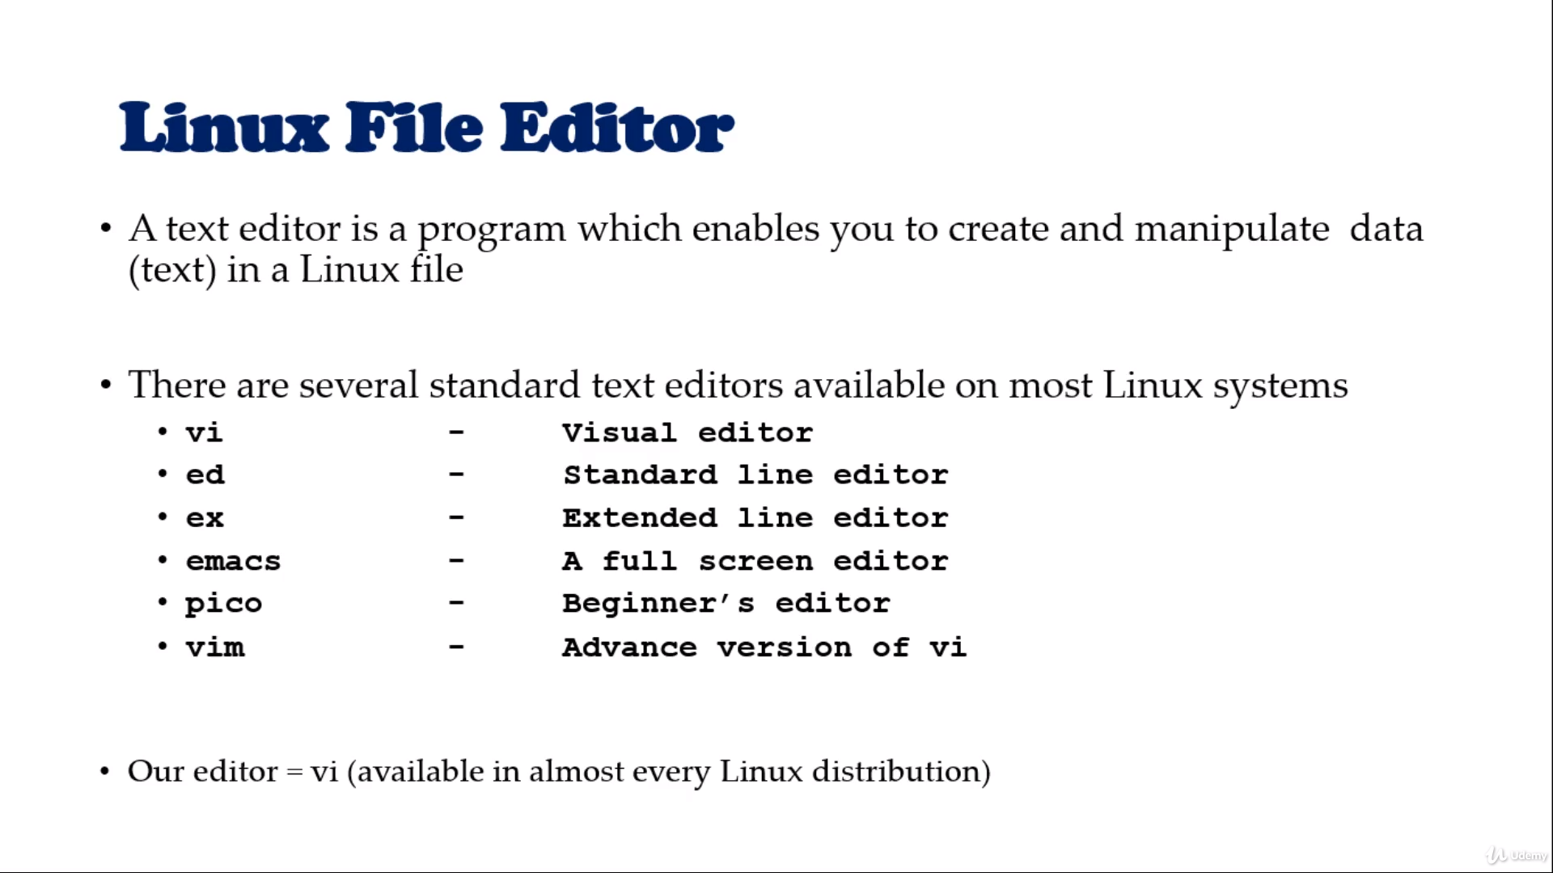

Slide 2
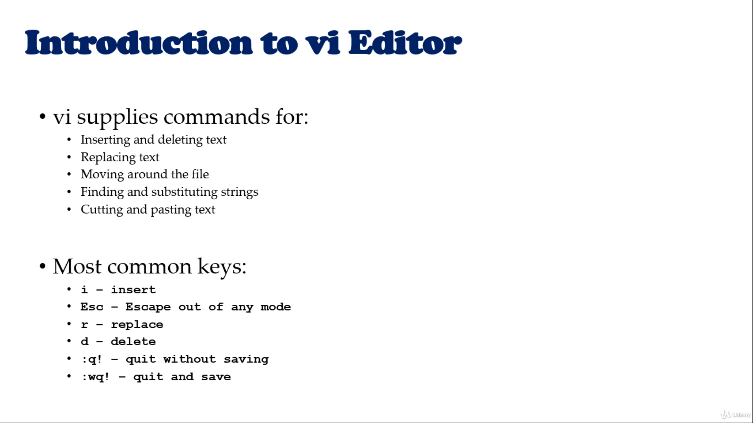

Slide 3


Slide 4


Slide 5


Slide 6
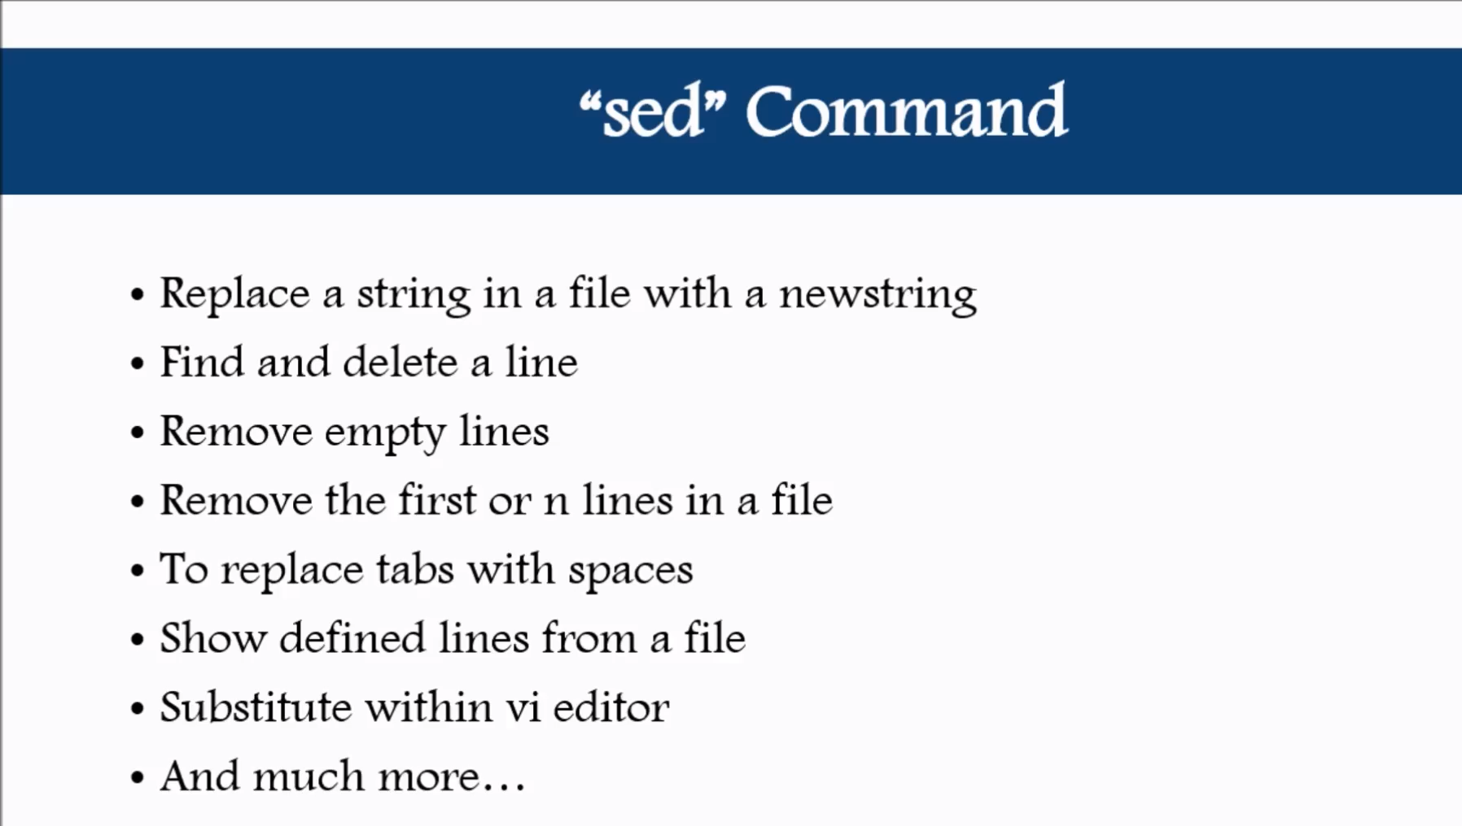

Slide 7
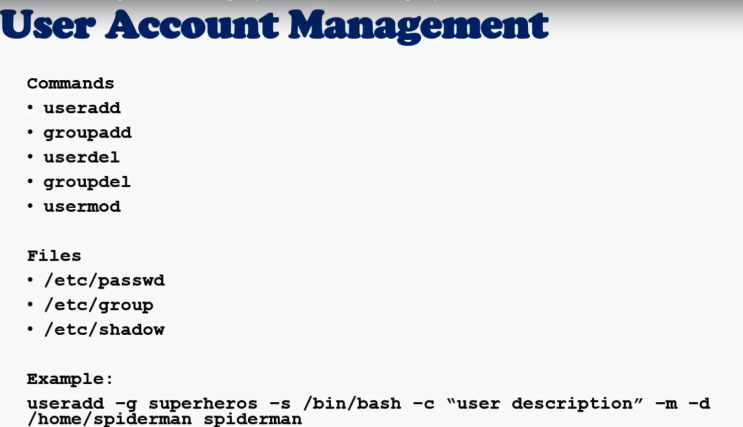

Slide 8
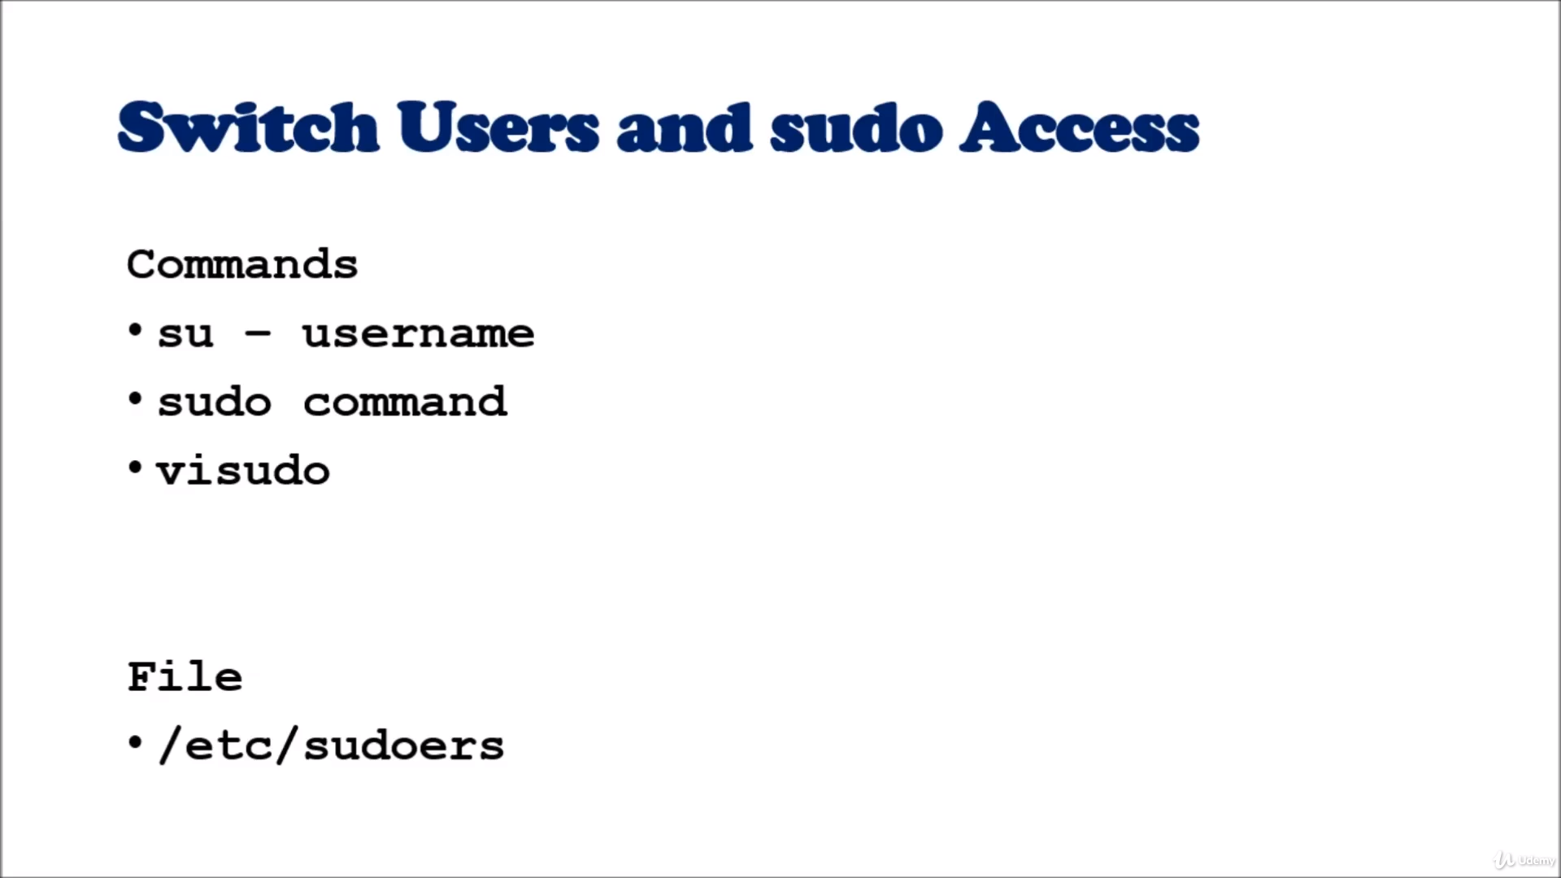

Slide 9


Slide 10



Slide 11
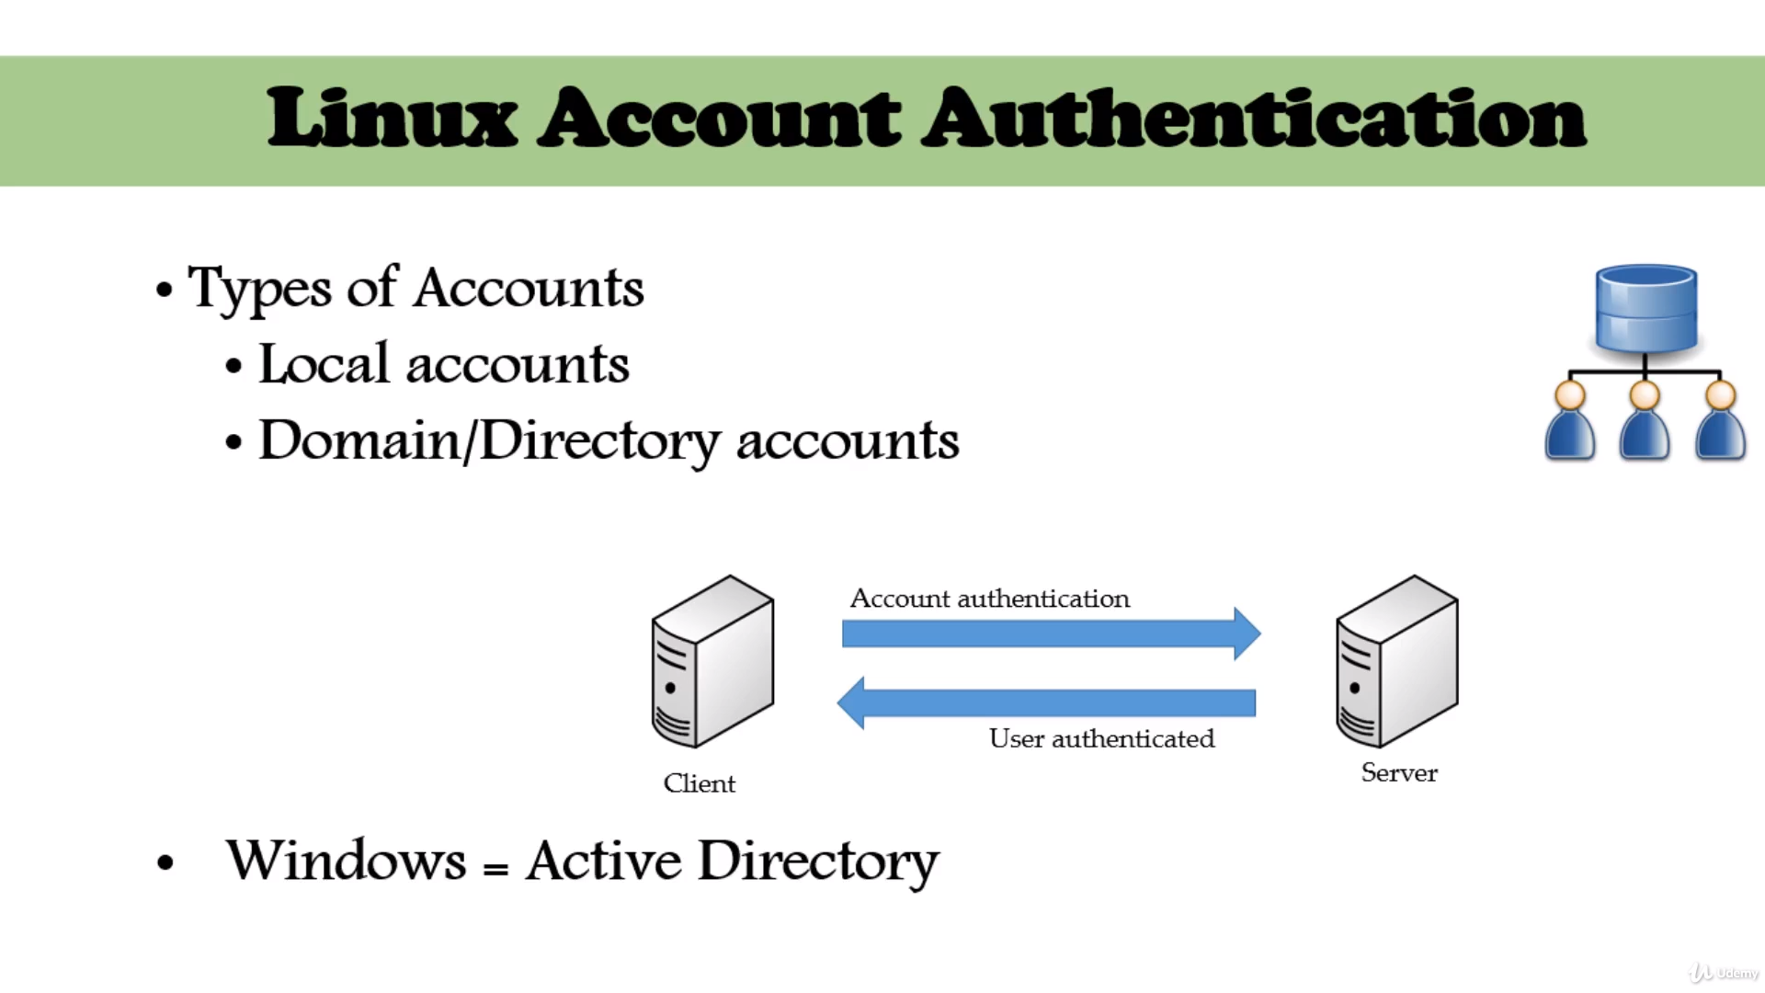

Slide 12
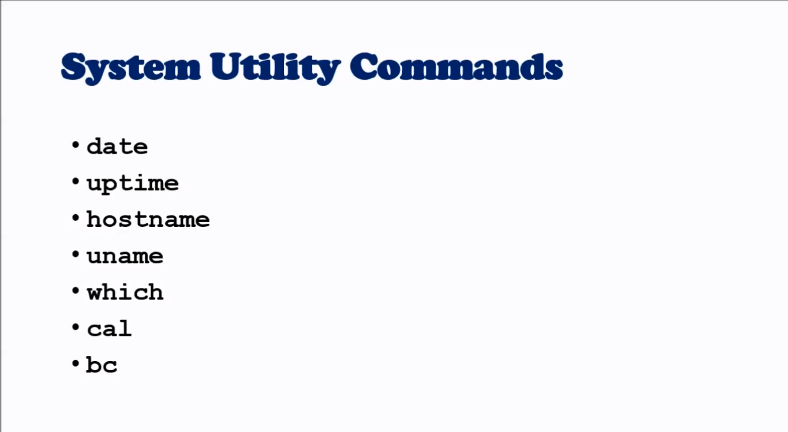

Slide 13
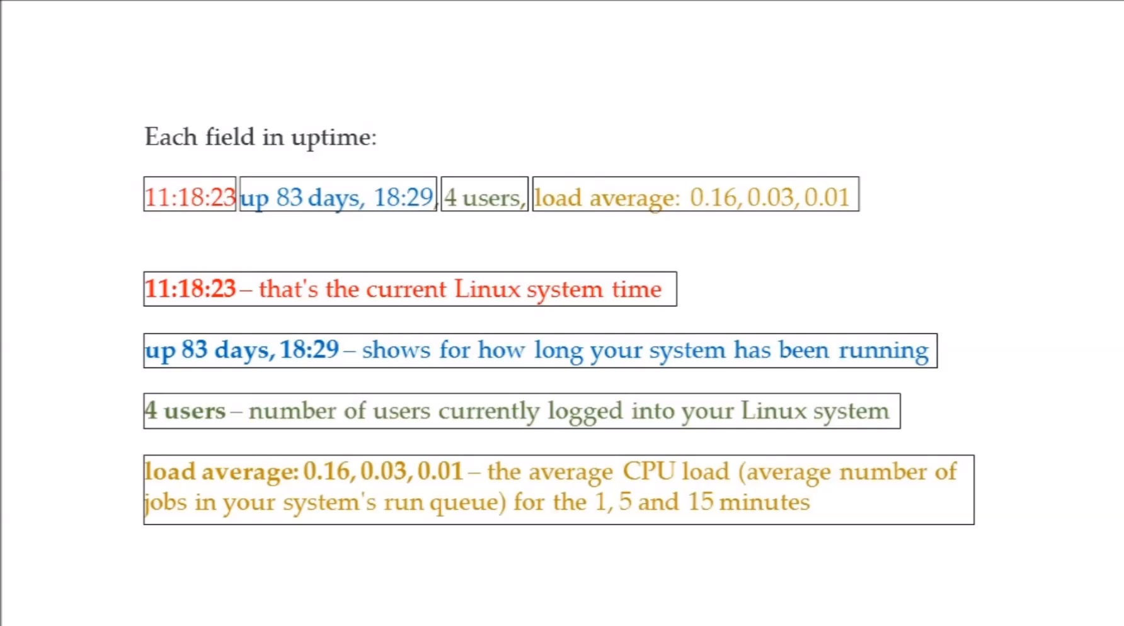

Slide 14
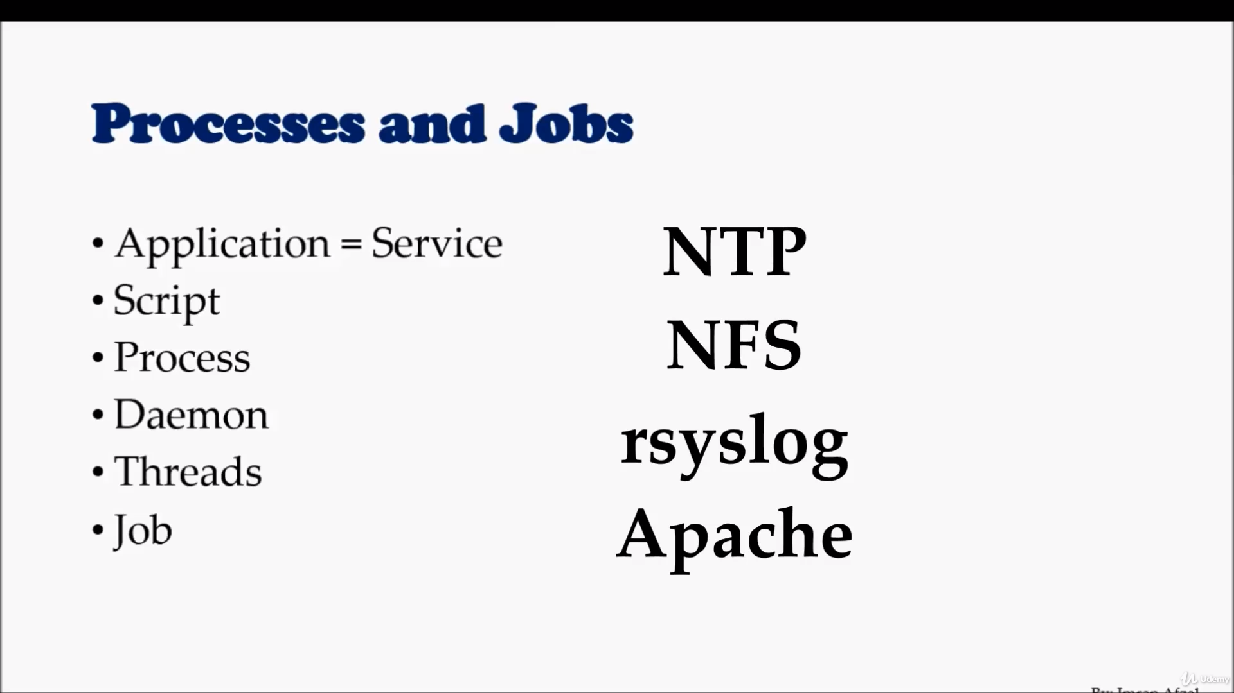

Slide 15
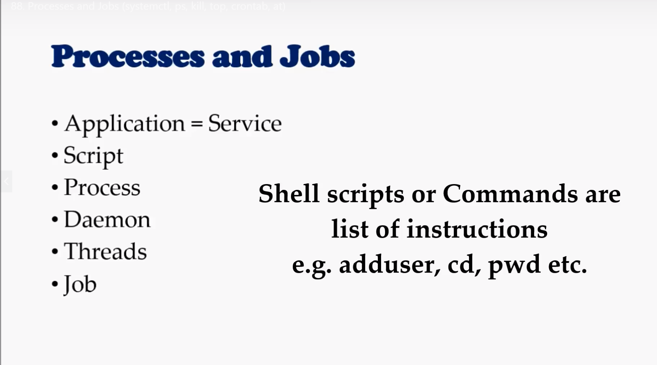

Slide 16
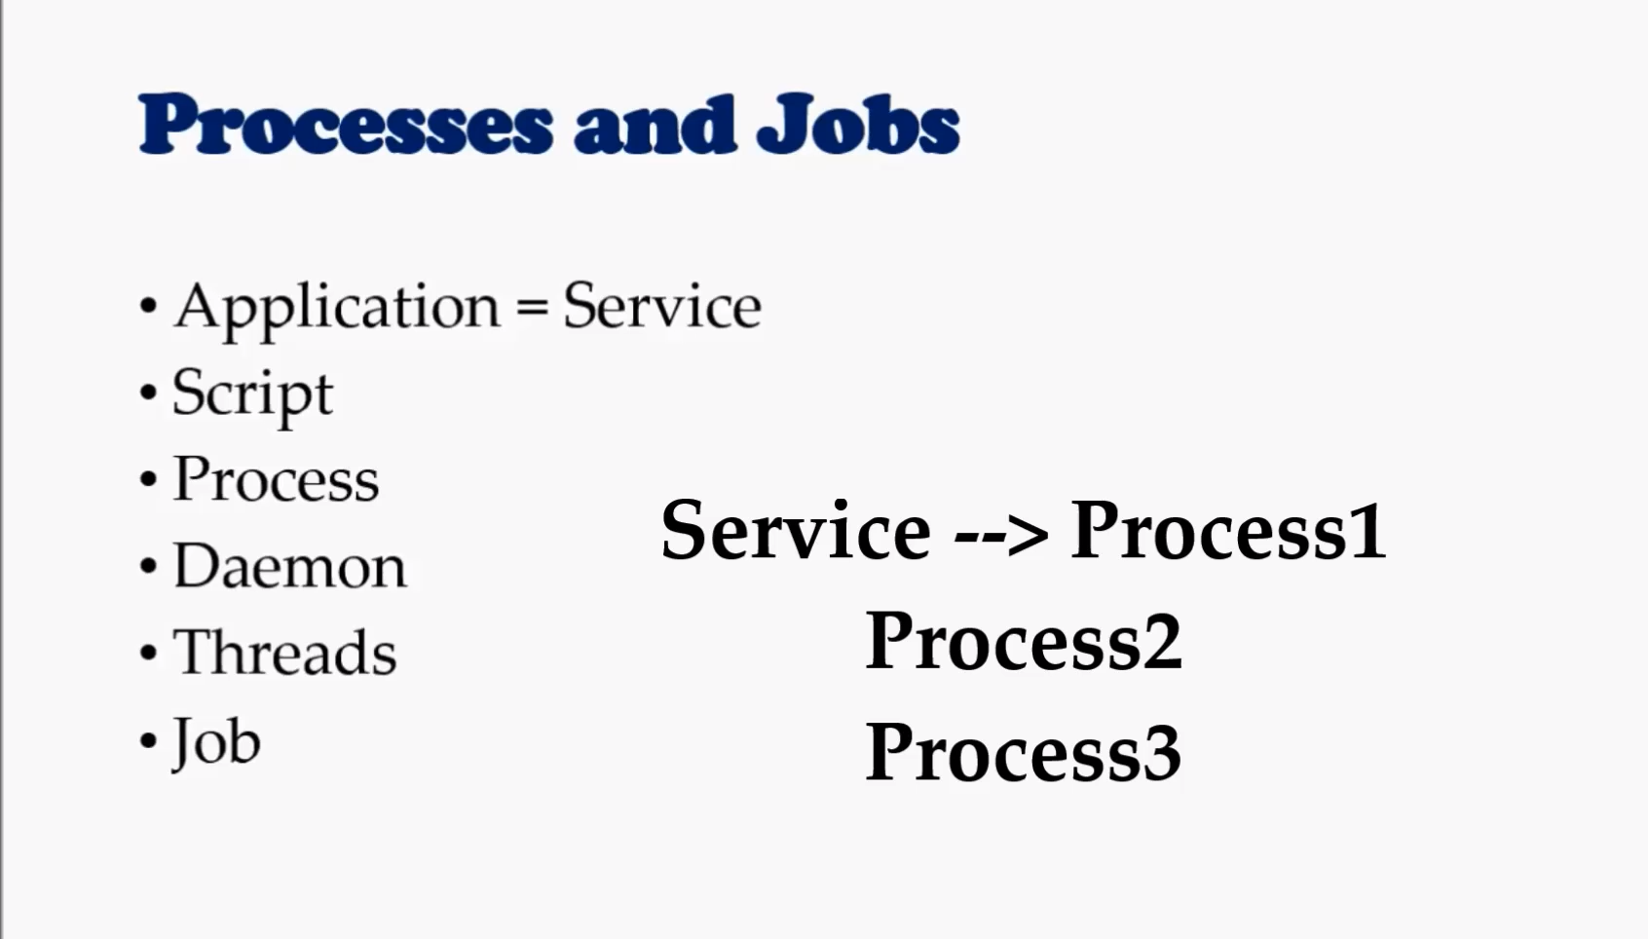

Slide 17
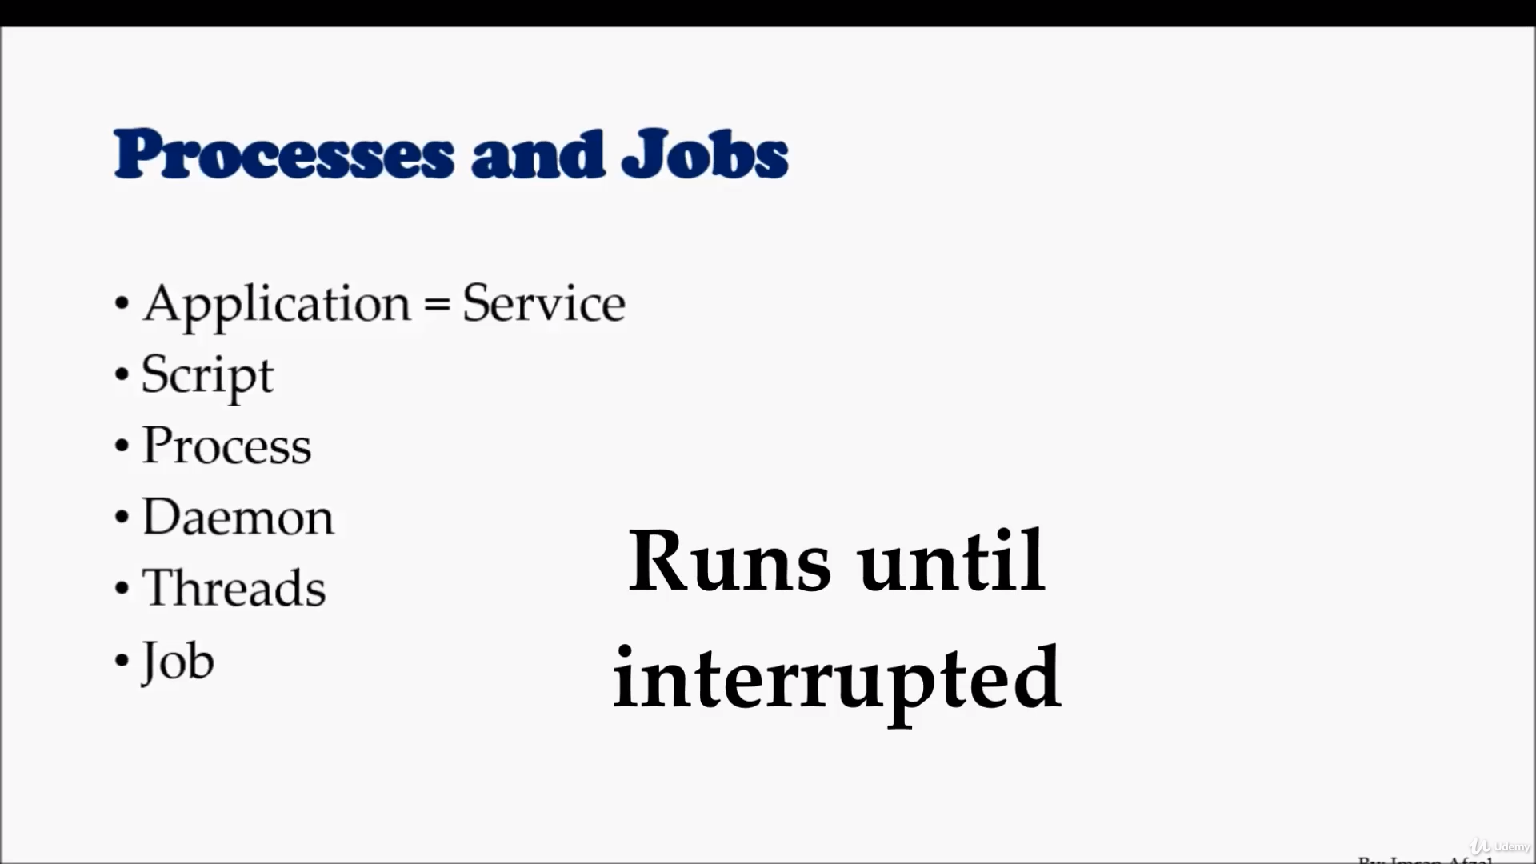

Slide 18
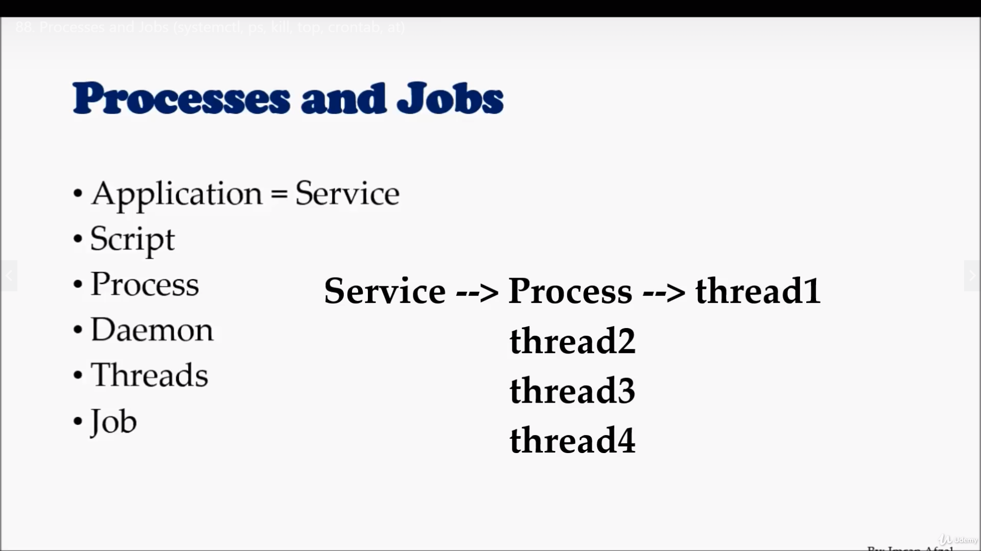

Slide 19
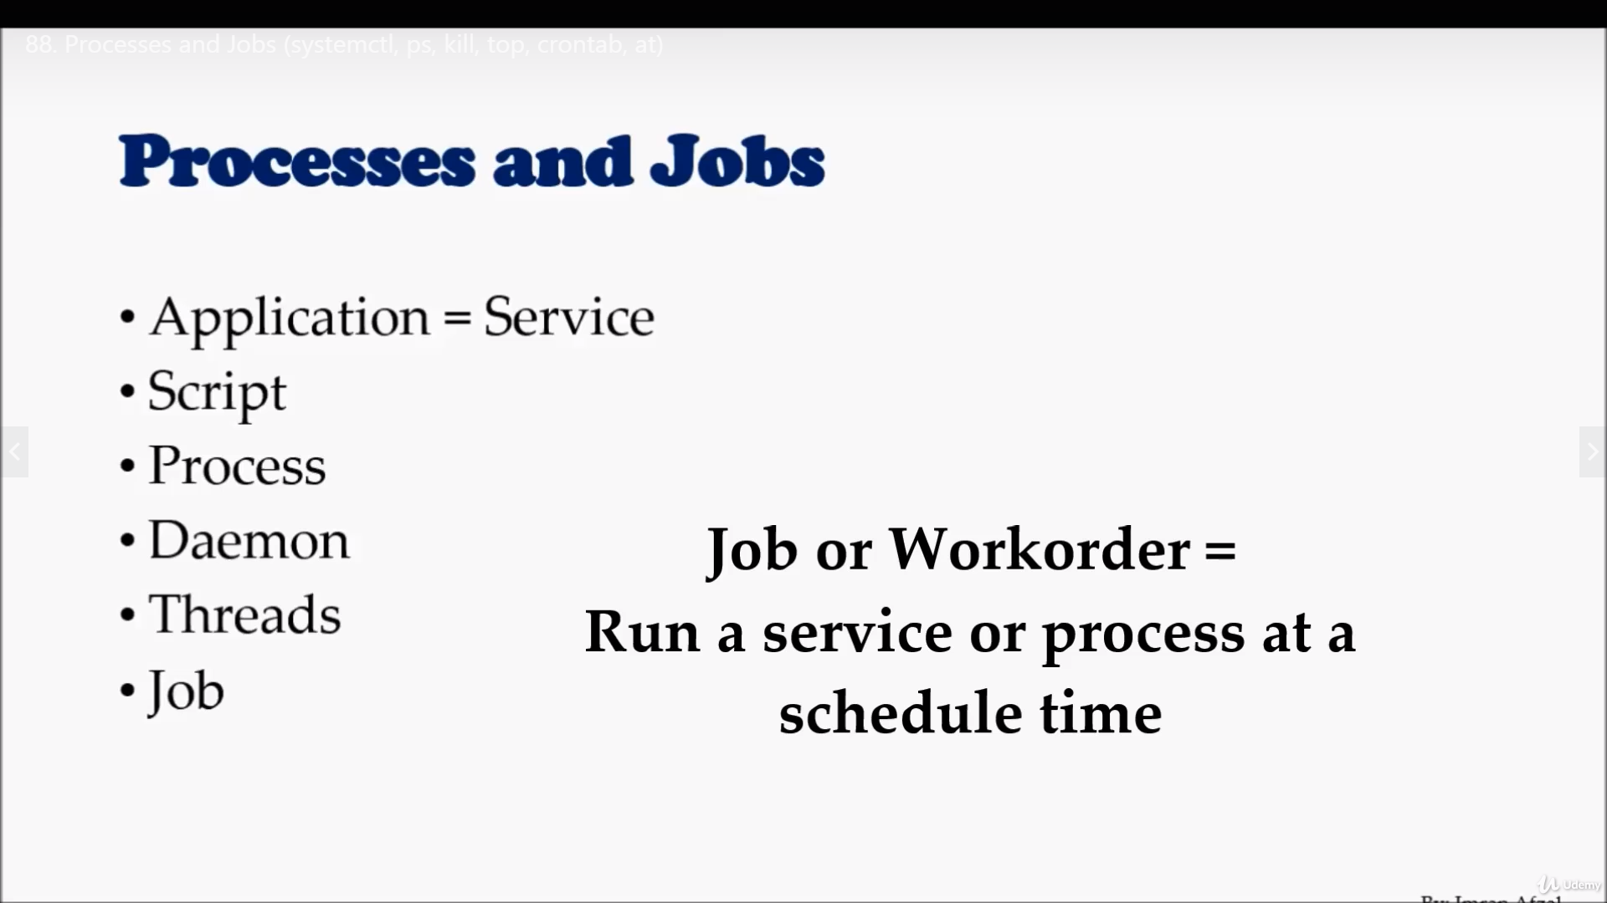

Slide 20
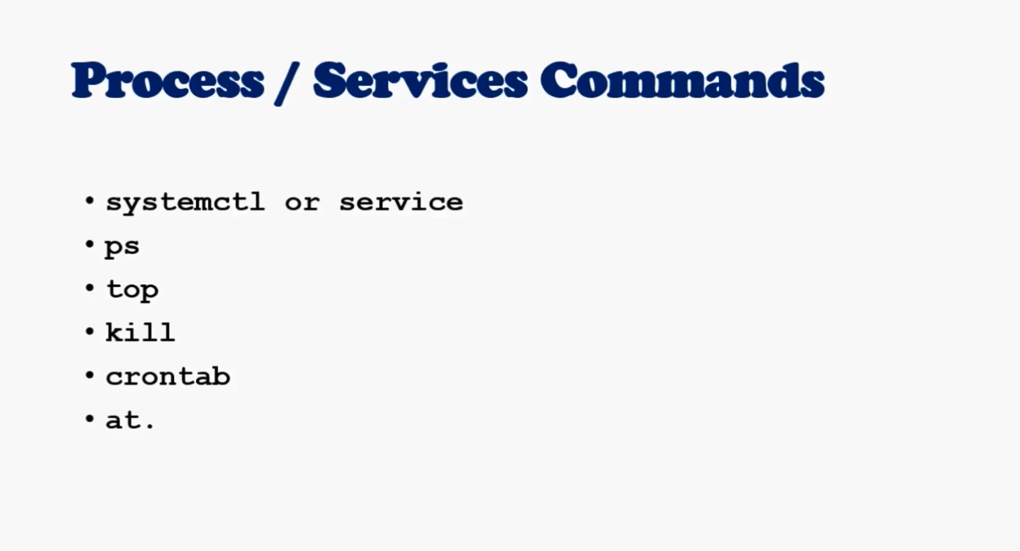

Slide 21
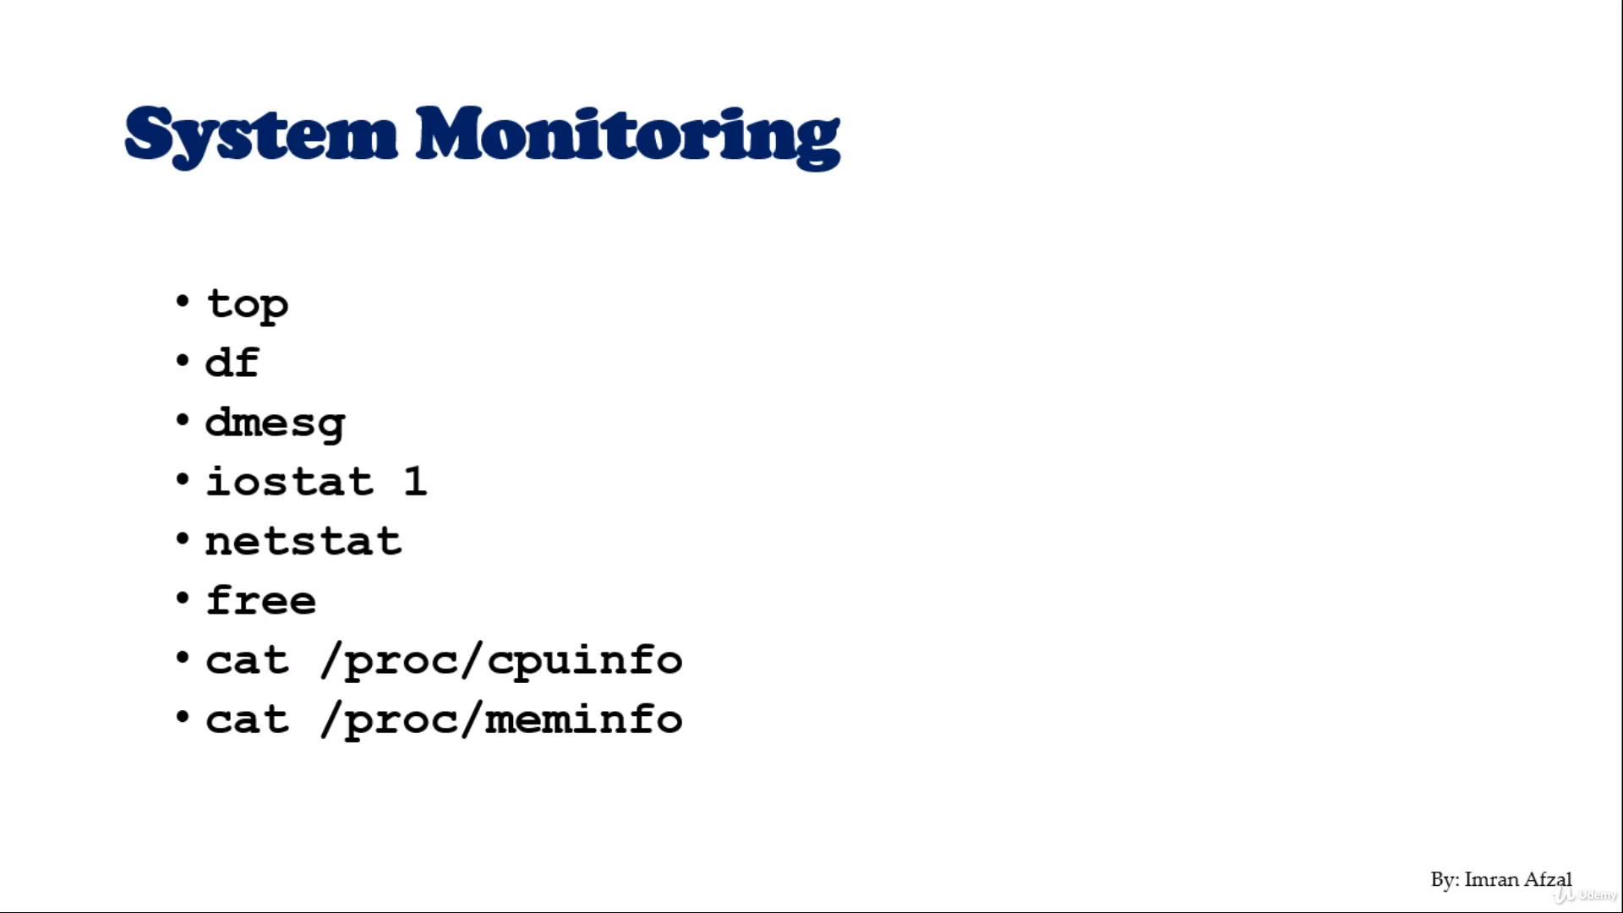

Slide 22
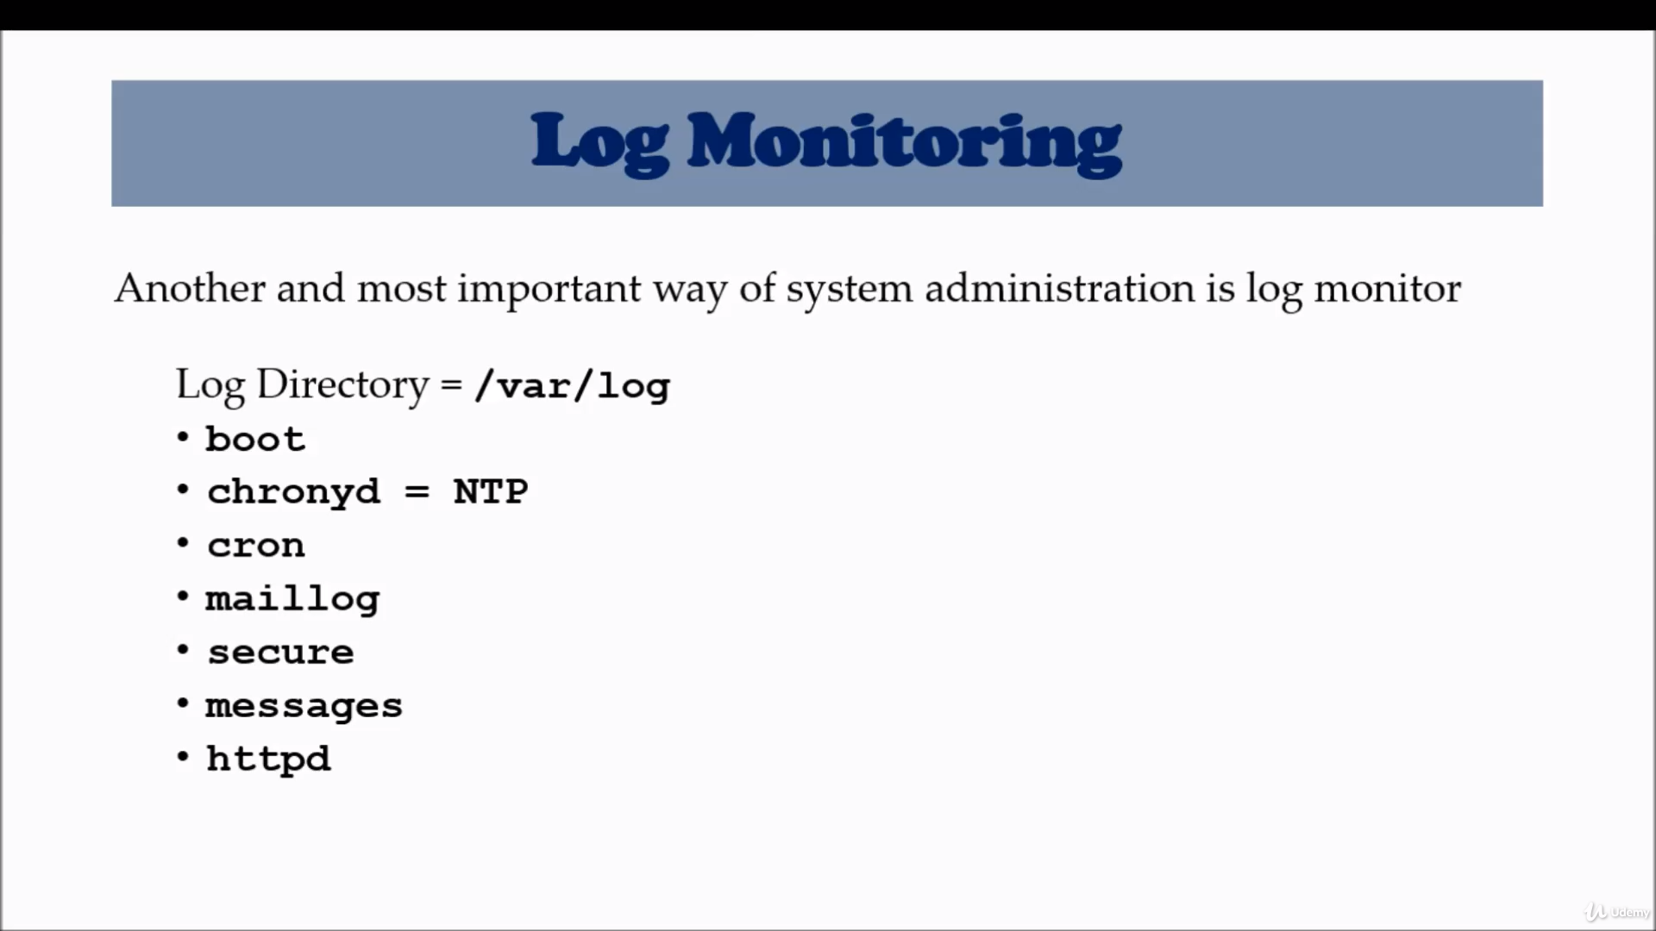

Slide 23
System Maintenance Commands
Shutdown
Init 0-6
Reboot
Halt

Slide 24
Changing Hostname
Hostnamectl set-hostname newhostname
File : in 7 ----- edit /etc/hostname

Slide 25
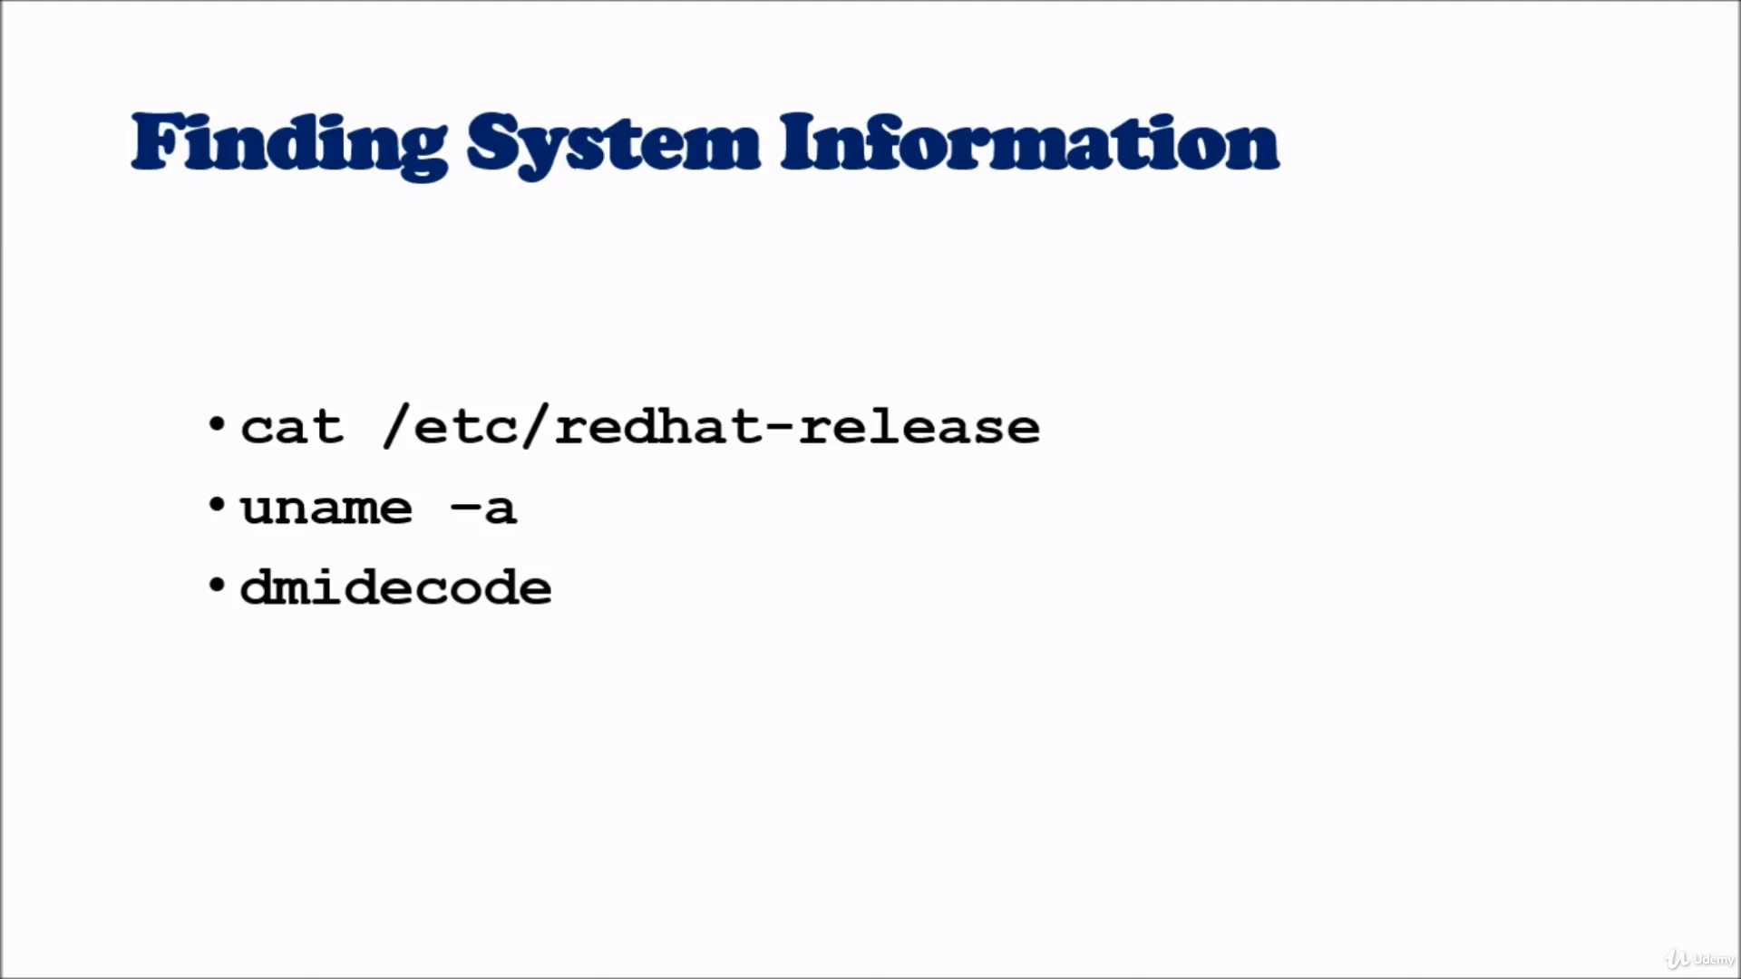

Slide 26
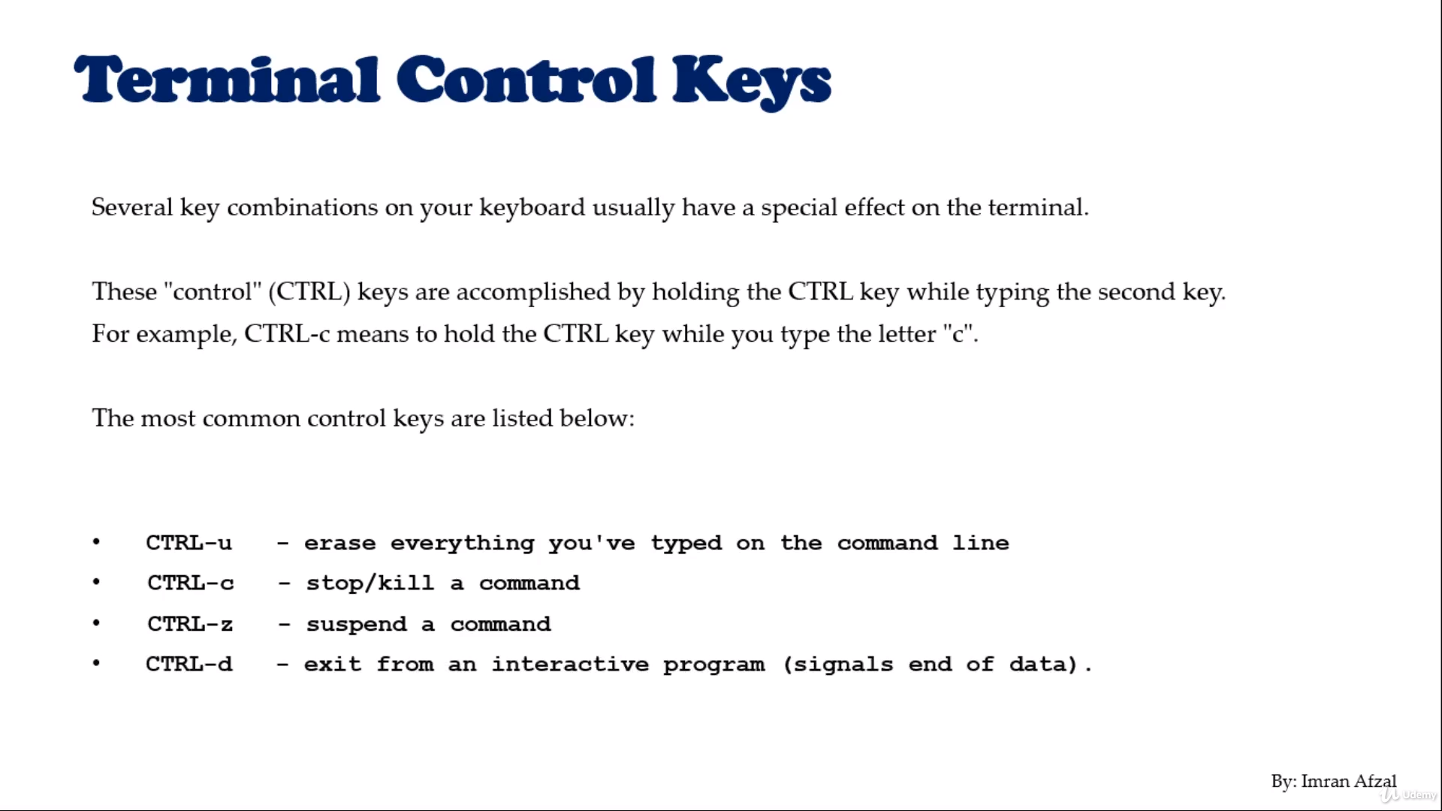

Slide 27
Terminal Commands
Clear
Clears Your Screen
Exit
Exit out of the shell, terminal and user session.

Slide 28
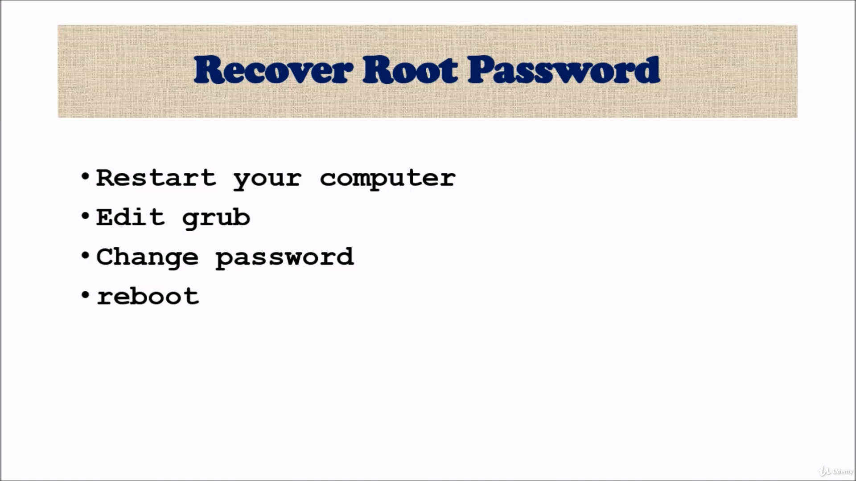

Slide 29
Steps For Root Password Change
Reboot system
Press “e”
ro - remove it
rw init=/sysroot/bin/sh
Ctrl-x
Chroot /sysroot
Passwd root
Newpasswd
Exit
reboot

